Slide 1
Fantastic 4: Our Team
Our team, Fantastic 4, is dedicated to developing a reliable and innovative gas detection system. We have combined our expertise in electronics, software, and chemistry to create a solution that can effectively identify and measure different gases.
Swam Singla
Shubham Goel
Inesh Dheer
Shreyas Mehta

Slide 2

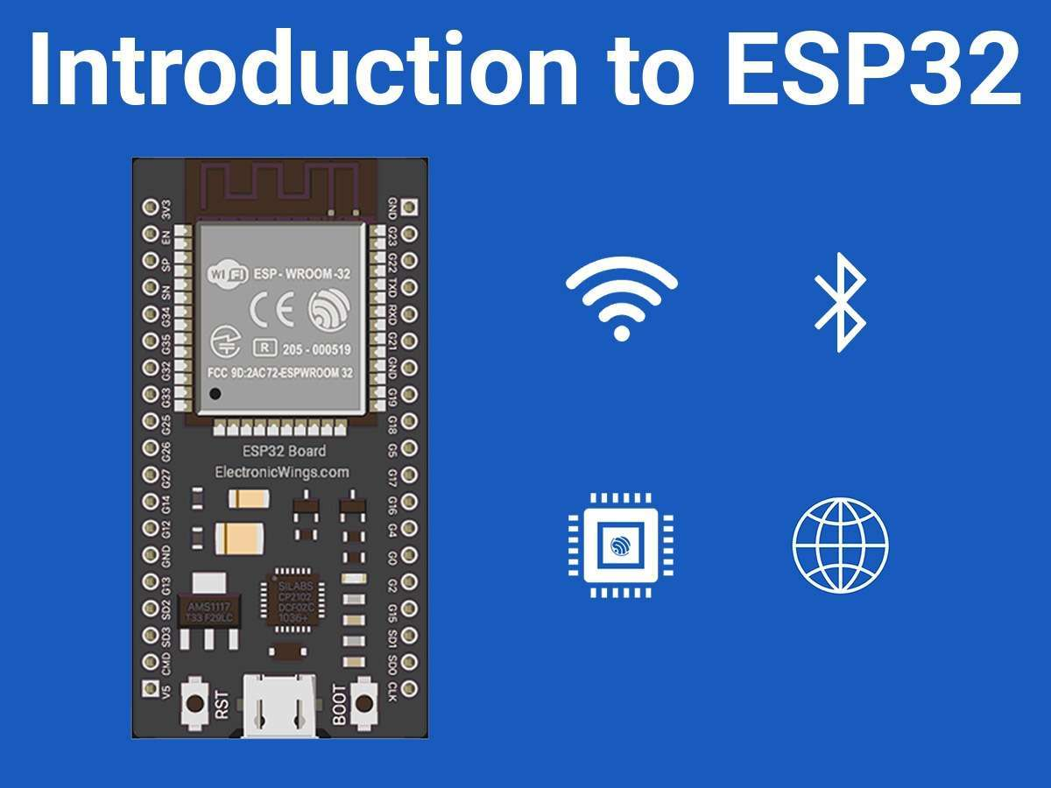
Gas Analyzer Project
This presentation outlines a project using gas analyzers to detect various gases in the environment. We will be using a combination of MQ2, MQ135, and MQ7 sensors for the detection of common gases like CO, LPG, methane, alcohol, and ammonia. The data from these sensors will be processed using an ESP32 microcontroller.
By Fantastic-4

Slide 3

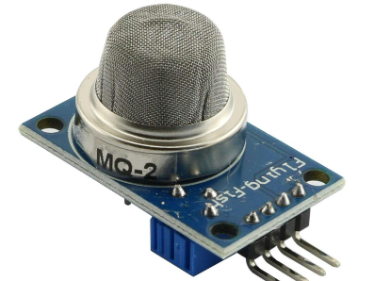
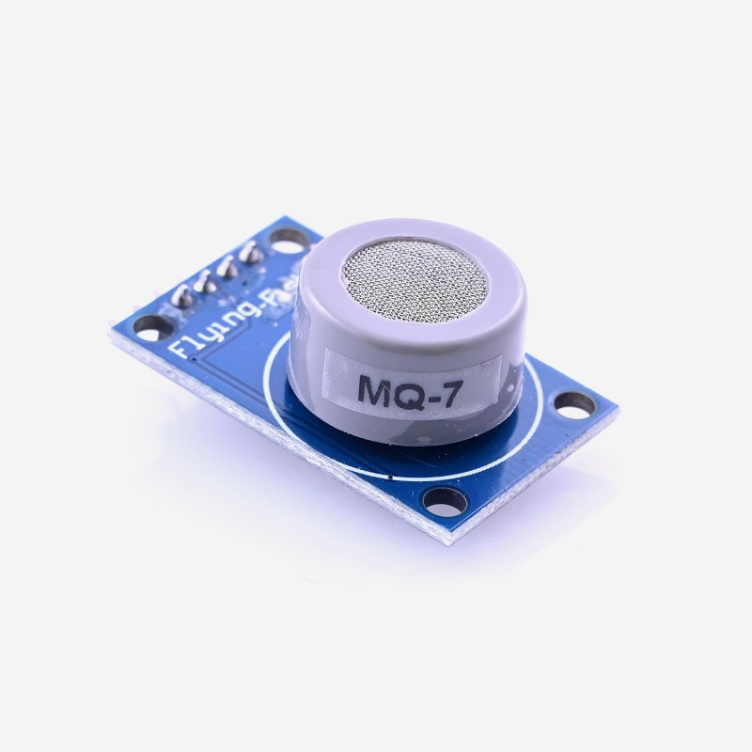
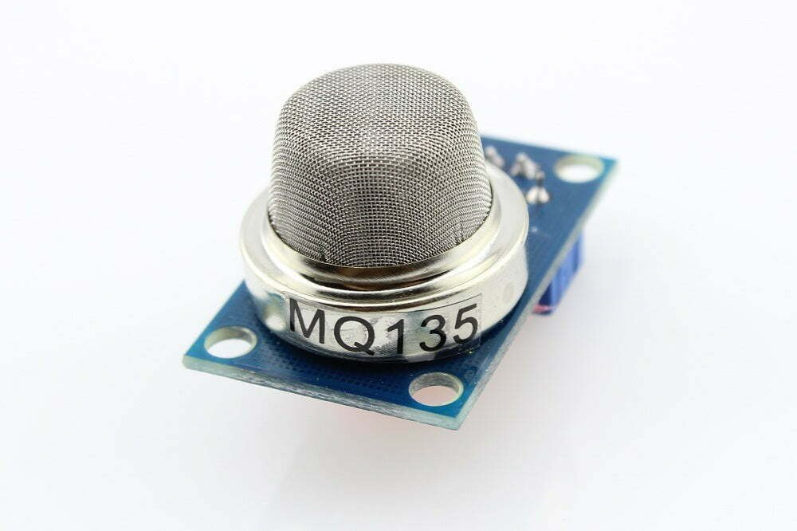
Gas Analyzers: MQ2, MQ135, MQ7
We selected three common and reliable gas sensors for this project: MQ2, MQ135, and MQ7. Each sensor is specifically designed to detect a particular range of gases, ensuring accurate readings.
1
MQ2
2
MQ135
3
MQ7
This sensor is sensitive to LPG, methane, alcohol, and smoke.
This sensor detects ammonia, alcohol, and various volatile organic compounds.
This sensor is specifically designed to detect carbon monoxide.

Slide 4

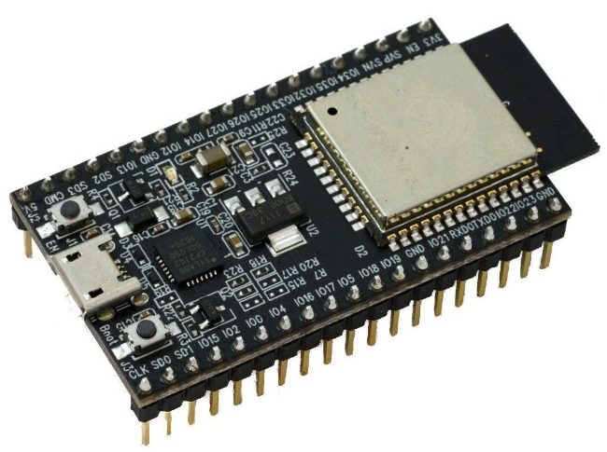
Microcontroller: ESP32
The ESP32 is a powerful and versatile microcontroller that serves as the brain of our gas detection system. It processes data from the sensors, performs calculations, and communicates with external devices.
Fast Processing
Connectivity
The ESP32 is known for its fast processing speeds, enabling real-time analysis of sensor data.
It supports multiple communication protocols, including Wi-Fi and Bluetooth, allowing for easy data transmission and remote monitoring.
Low Power Consumption
The ESP32's low power consumption makes it ideal for battery-powered applications.

Slide 5

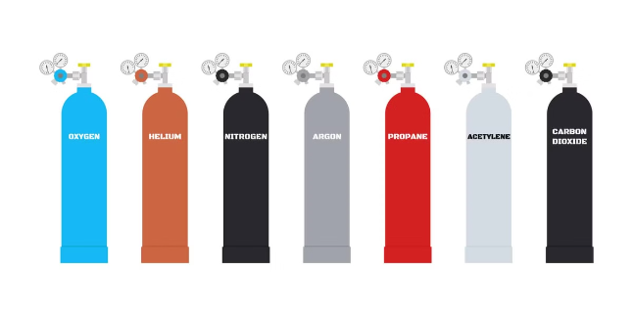
Gases Detected
Our gas detection system is capable of identifying and measuring various gases commonly found in residential and industrial environments.
Gas
Sensor
CO
MQ7
LPG
MQ2
Methane
MQ2
Alcohol
MQ135
NH3
MQ135

Slide 6

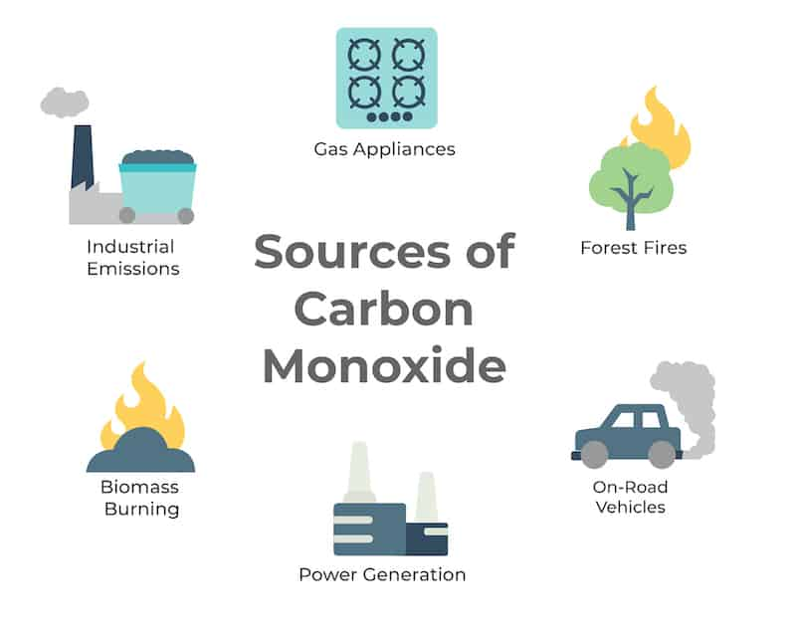
CO (MQ7)
Carbon monoxide is a colorless and odorless gas that can be dangerous at high concentrations. Our system uses the MQ7 sensor to detect CO levels.
1
Source 1
Exhaust fumes from vehicles.
2
Source 2
Burning candles or incense.
3
Detection
The MQ7 sensor measures CO levels and triggers an alert if concentrations exceed safe limits.

Slide 7

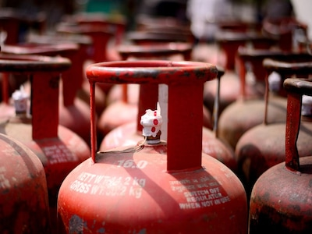
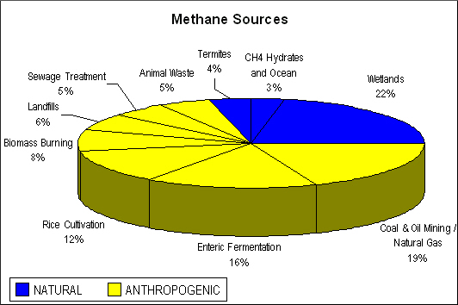



LPG, Methane (MQ2)
LPG and methane are flammable gases that require careful monitoring. The MQ2 sensor can detect both gases.
LPG Sources
Methane Sources
Safety Measures
LPG is commonly used for cooking and heating.
Methane is a natural gas that is also used for cooking and heating.
Detecting leaks early is crucial for preventing accidents and ensuring safety.

Slide 8





Gas Generation Techniques
We employ various methods to generate specific gases for testing our gas detection system. This allows us to accurately calibrate and verify the performance of our sensors.
CO
Exhaust fumes from a running car or a burning candle.
LPG & Methane
Burning gas from a stove or a gas cylinder.
Alcohol
Evaporation of alcohol from hand sanitizer.
Ammonia
Ammonia-based cleaners release ammonia fumes.

Slide 9
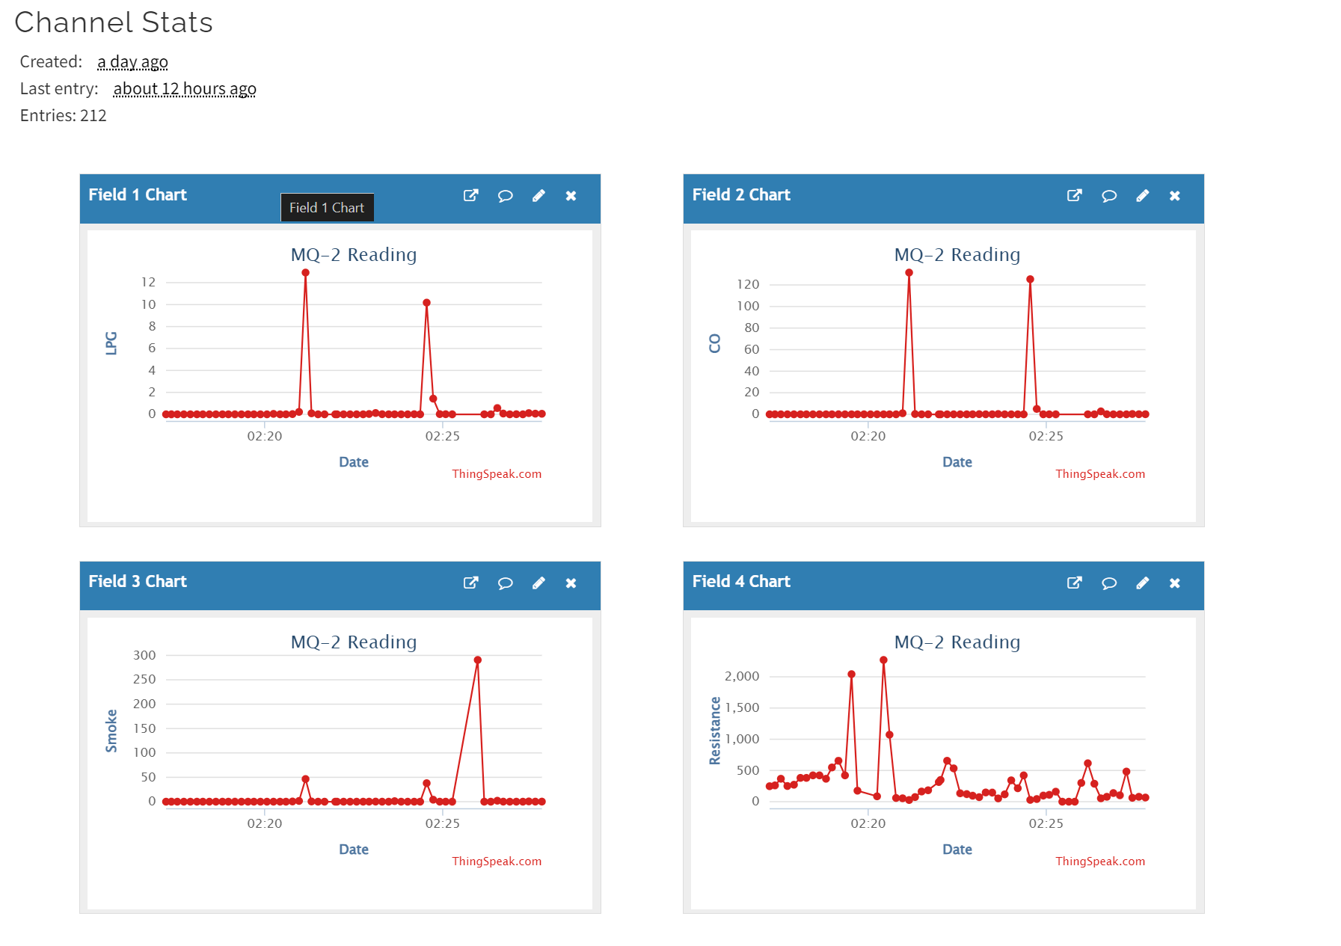
Week 1/2 - Data Collection (Raw Data)

Slide 10

Week 1/2 Report:
Inesh | Shreyas | Shubham | Swam
Wrote the main working code for the ESP32/MQ-2 sensor. Made and setup the ThingSpeak channel which in turn made the graphical analysis possible. Made this presentation. | Made Specific changes in code base (specifically header files) for shifting from Arduino to ESP32. Checked For Calibration Methods in datasheet along with specific variable analysis. Converted CSV data to graphically analyzable form. | Started working on the platform Figured out MQTT was successful in setting up “mosquito” broker and receiving data from ESP32 to flask server through the broker. | Datasheet analysis of MQ-2, calibrated ppm values using graphs of ppm vs log(rs/ro) given in datasheet. Analysis of data collected(LPG, smoke and CO).

Slide 11
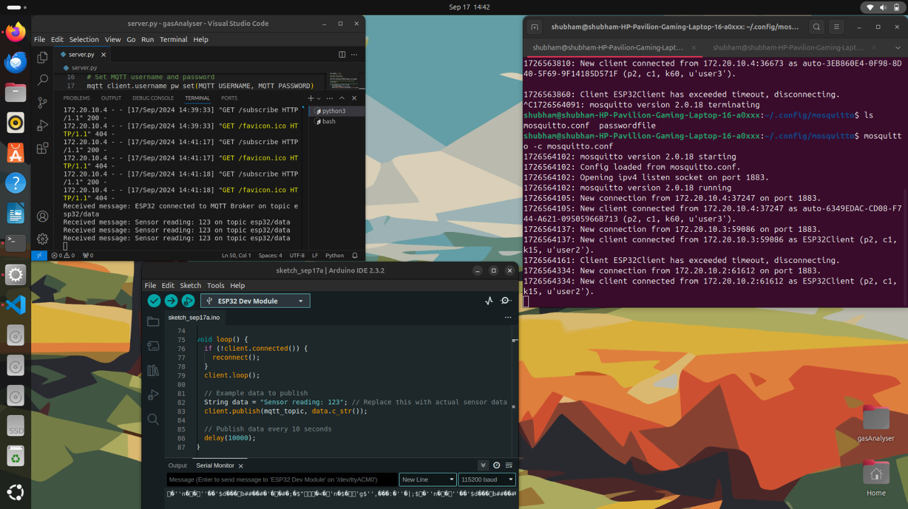

Slide 12
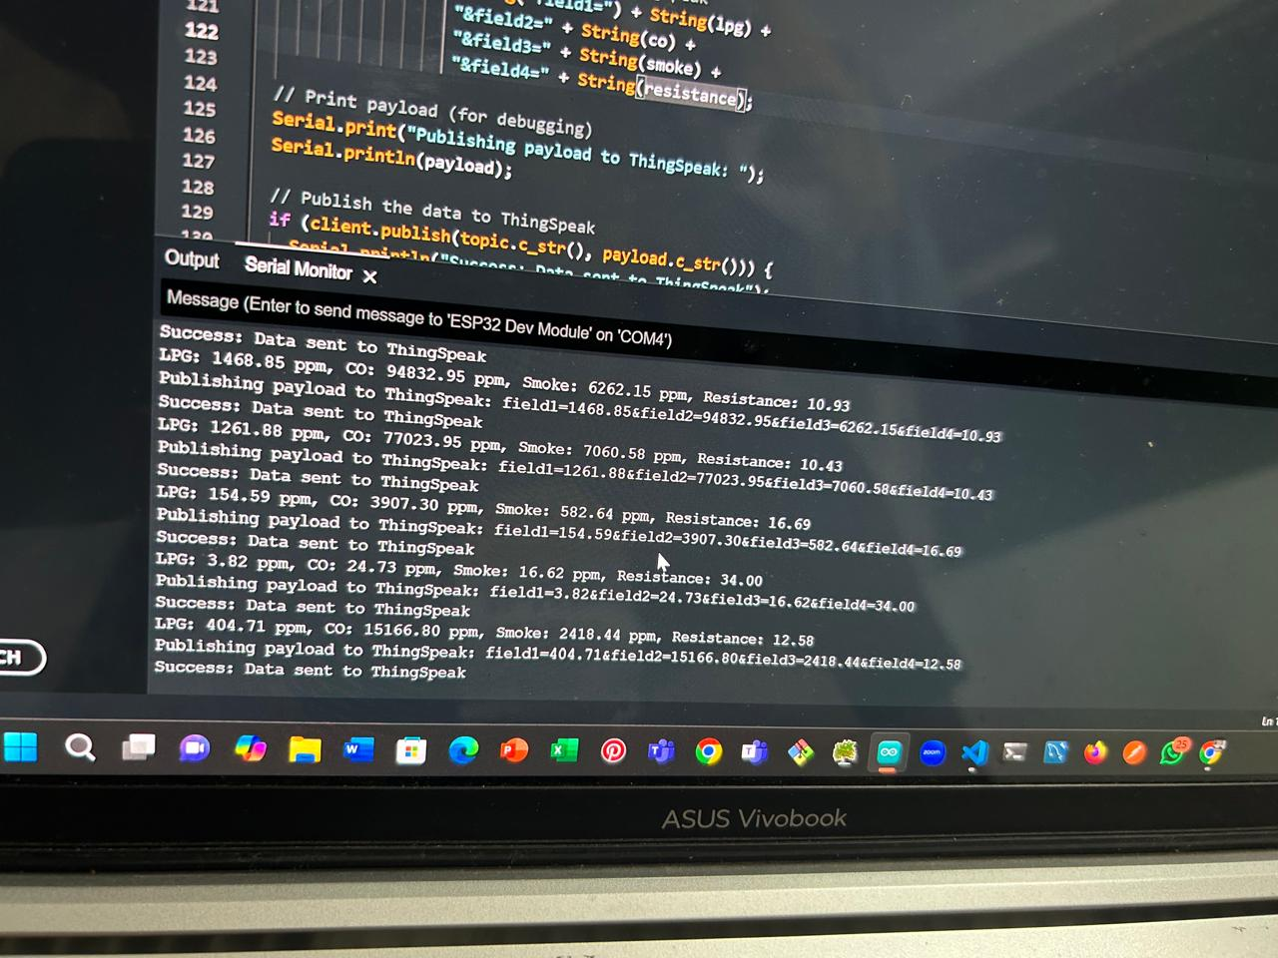
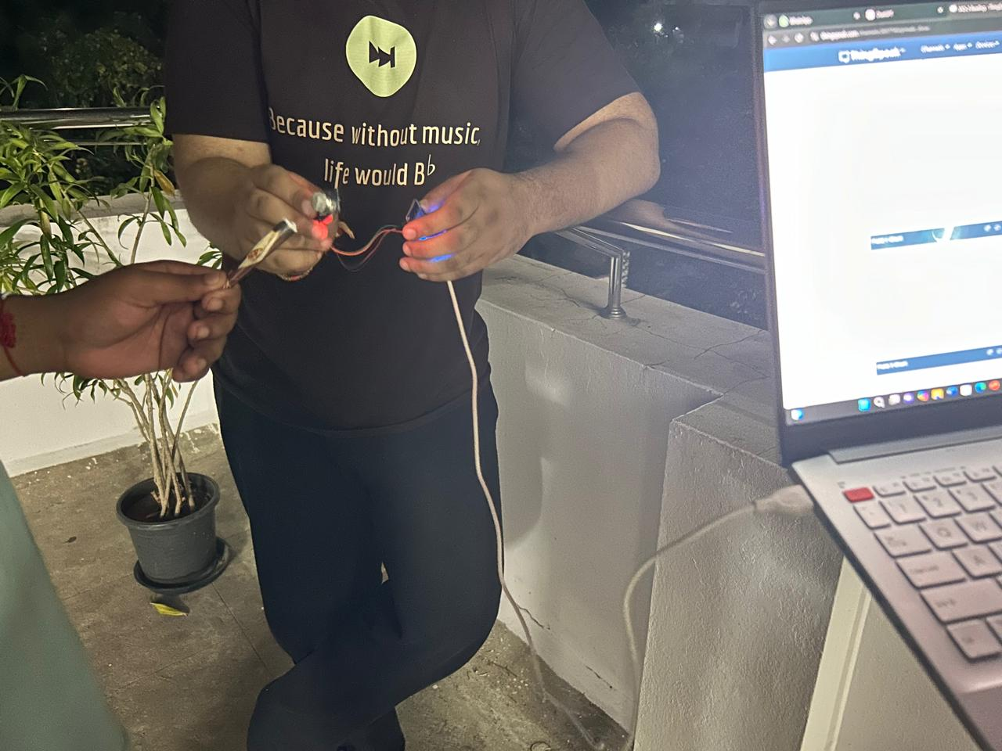
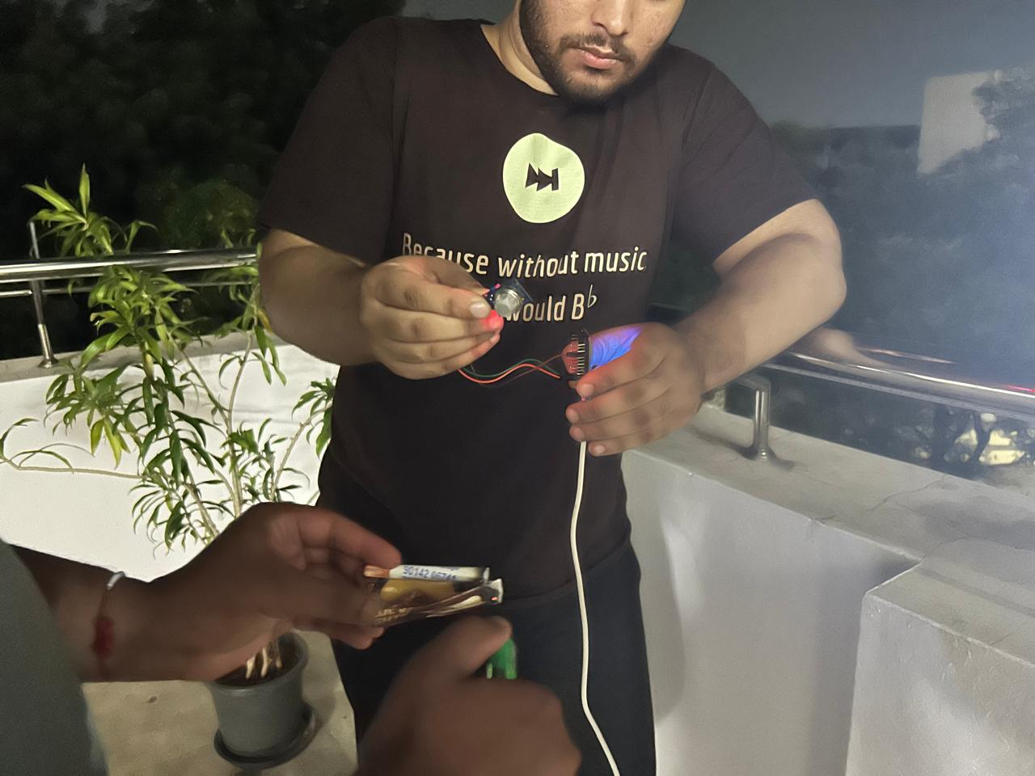
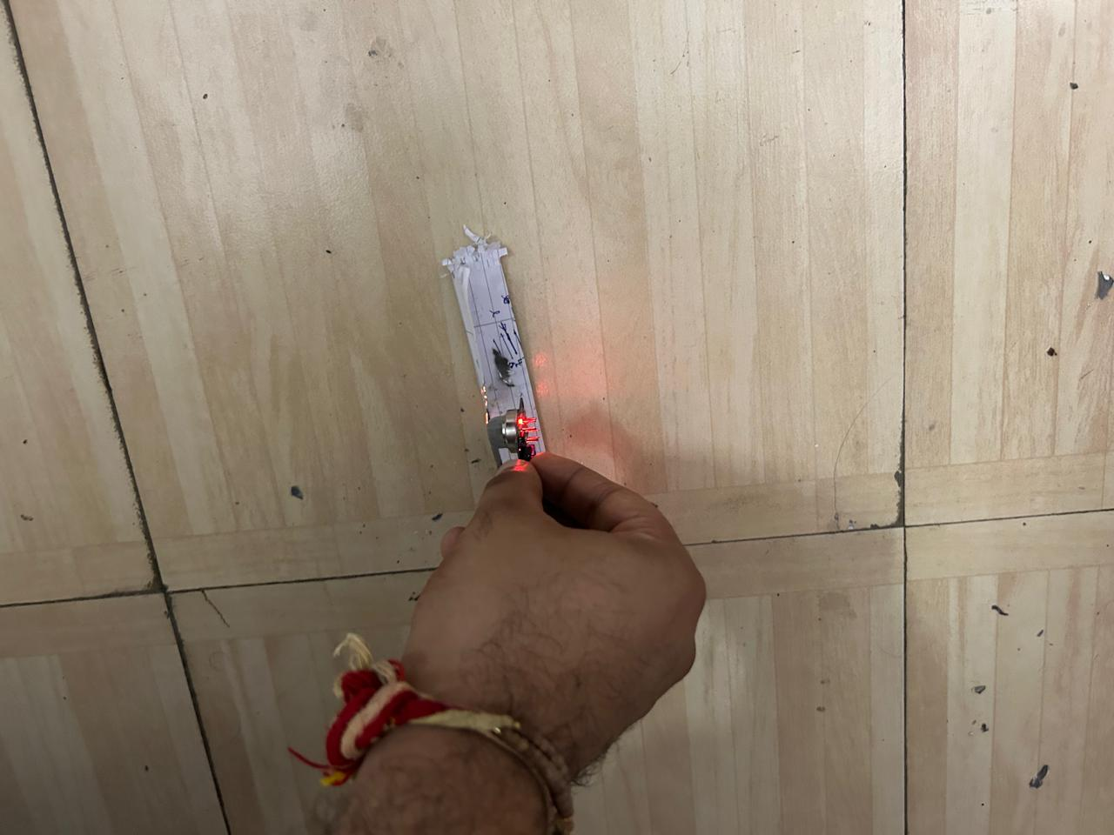
A glimpse of
our work

Slide 13
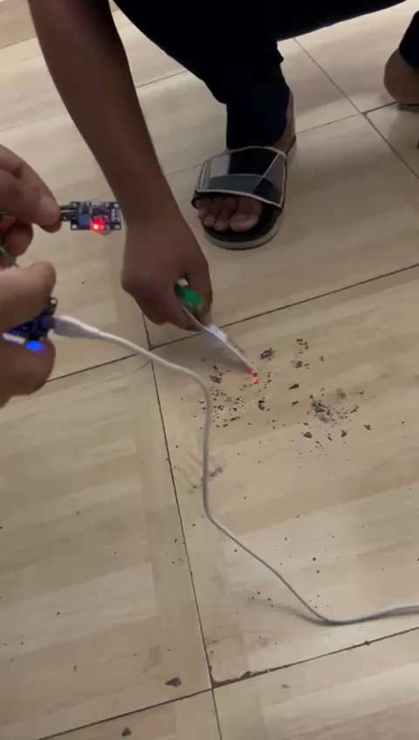

Slide 14
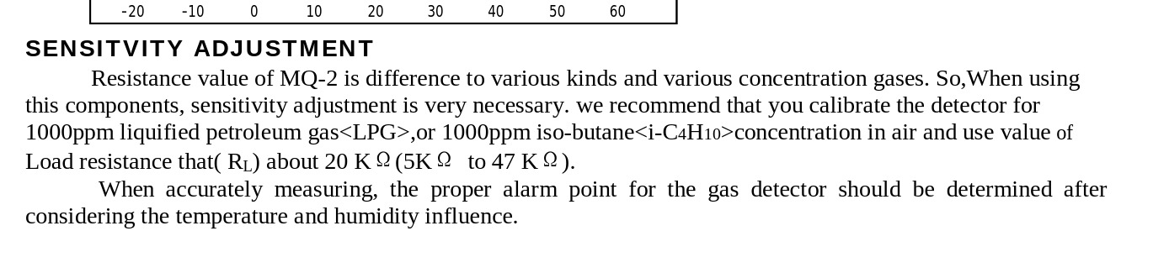
SITE : https://www.mouser.com/datasheet/2/321/605-00008-MQ-2-Datasheet-370464.pdf?srsltid=AfmBOoqtTlu7Vq4f_Cez8RST9gdqlQE1DE0eE3xeVSmNGci9Qd8Pf595
Header Site Reference: https://github.com/labay11/MQ-2-sensor-library

Slide 15
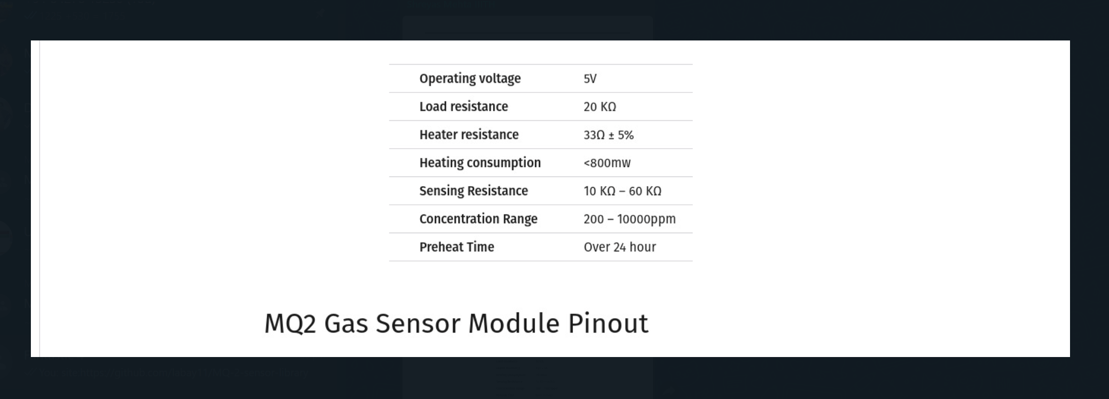
SITE:https://lastminuteengineers.com/mq2-gas-senser-arduino-tutorial/

Slide 16
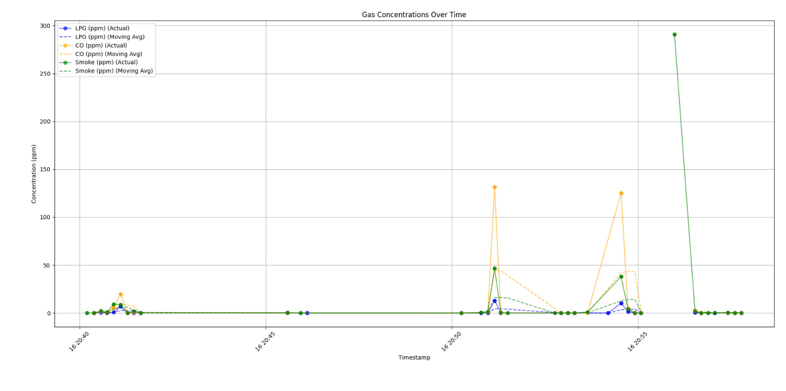

Slide 17
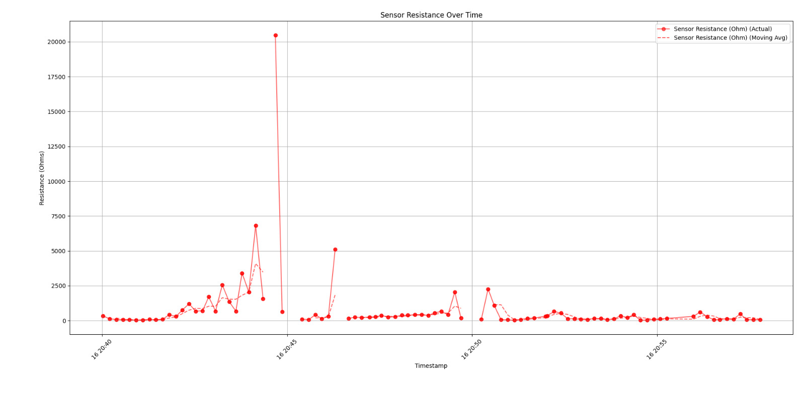

Slide 18
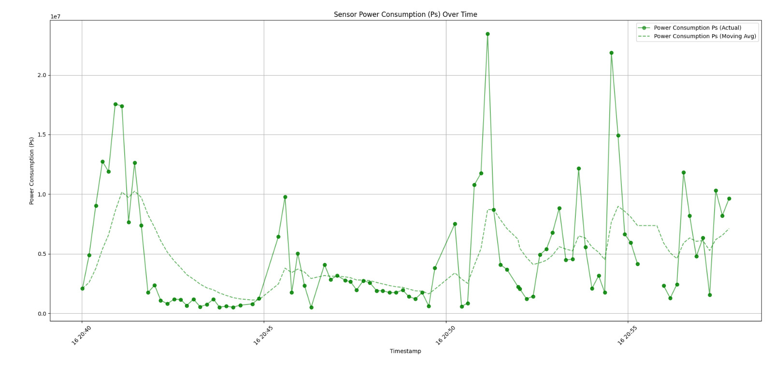
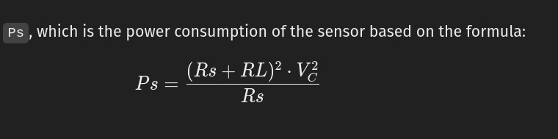

Slide 19
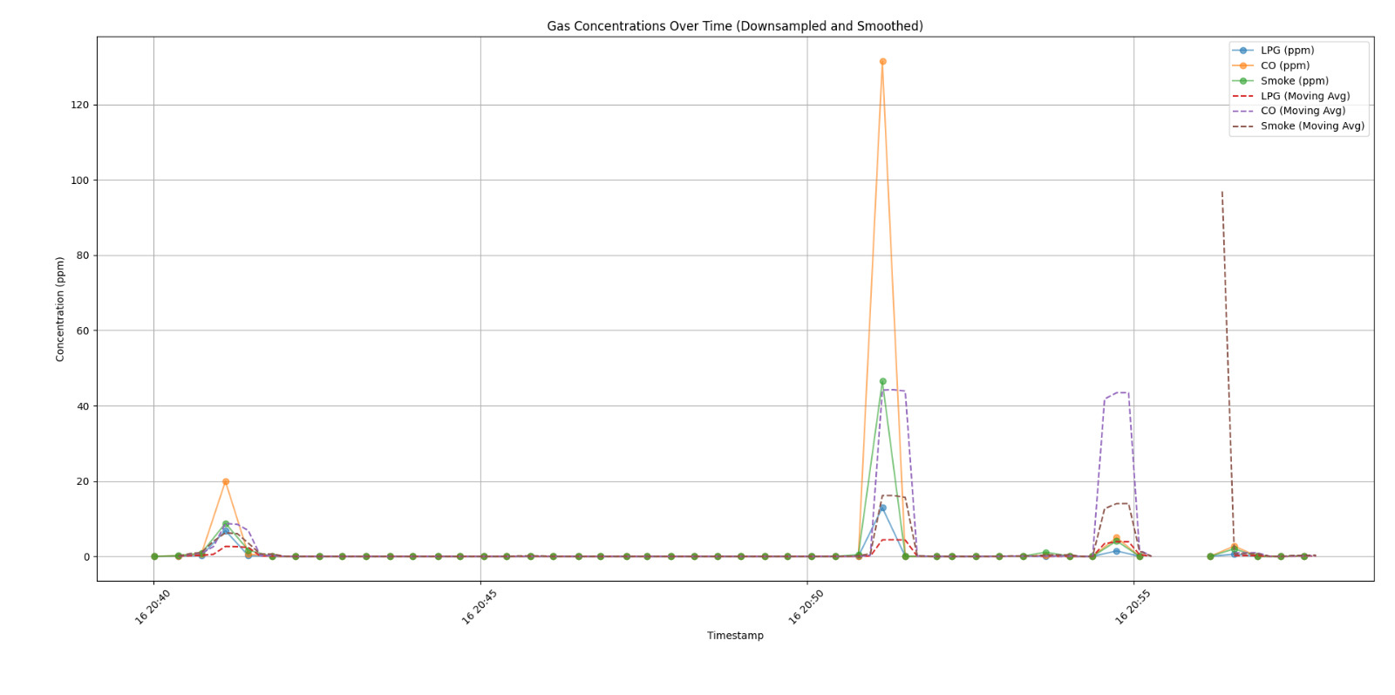

Slide 20
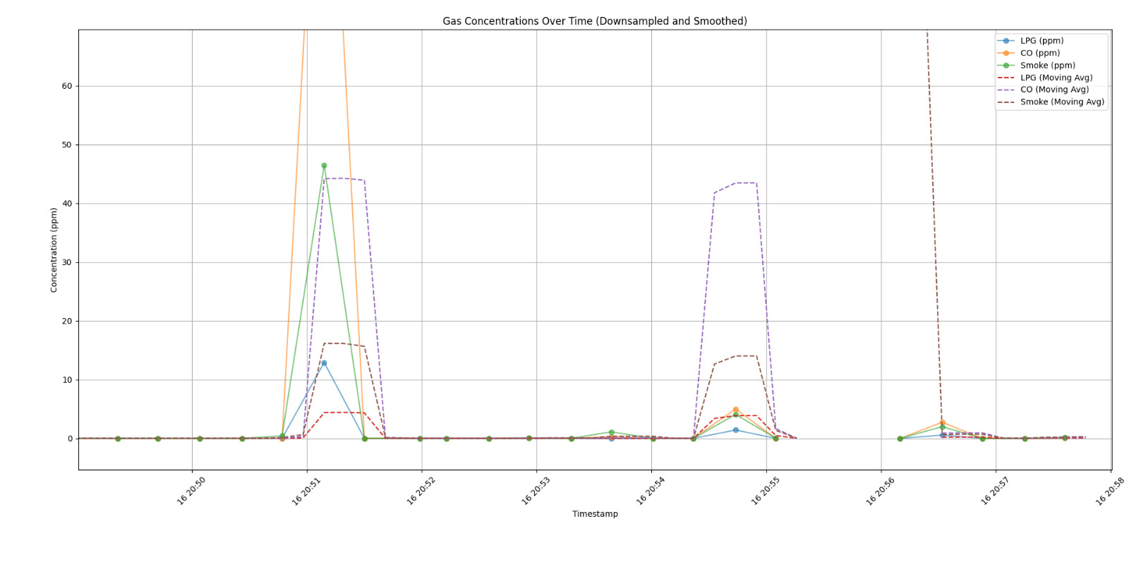

Slide 21
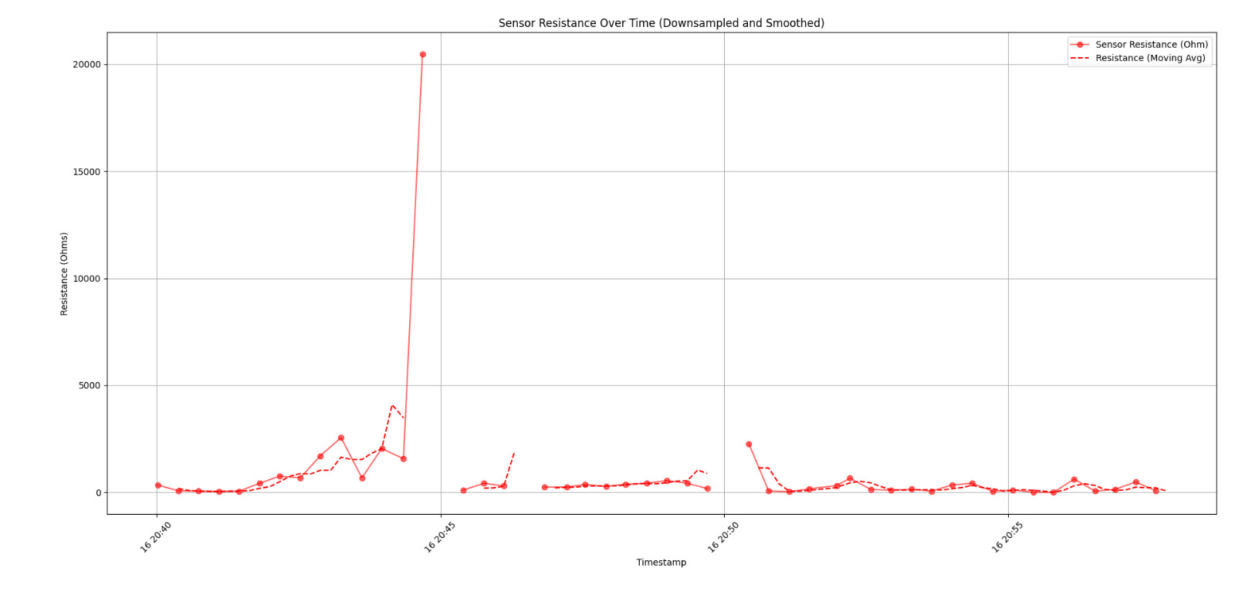

Slide 22
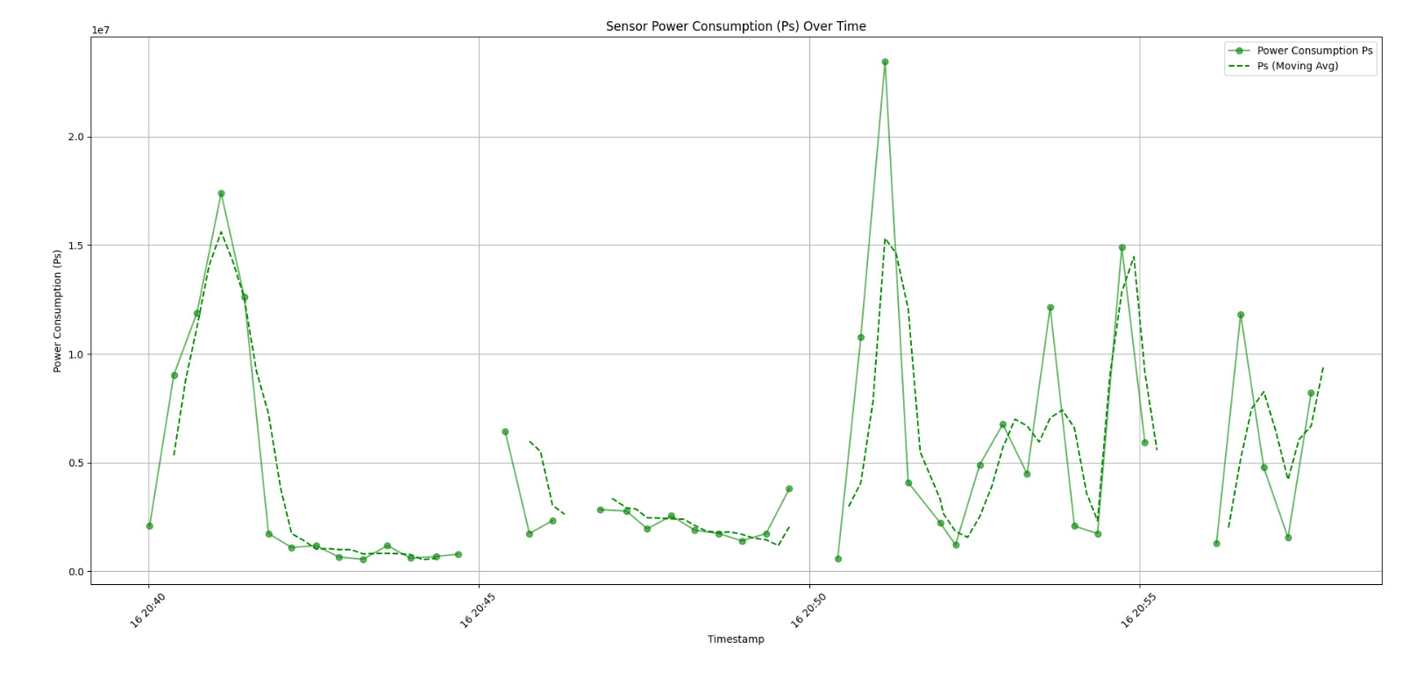

Slide 23
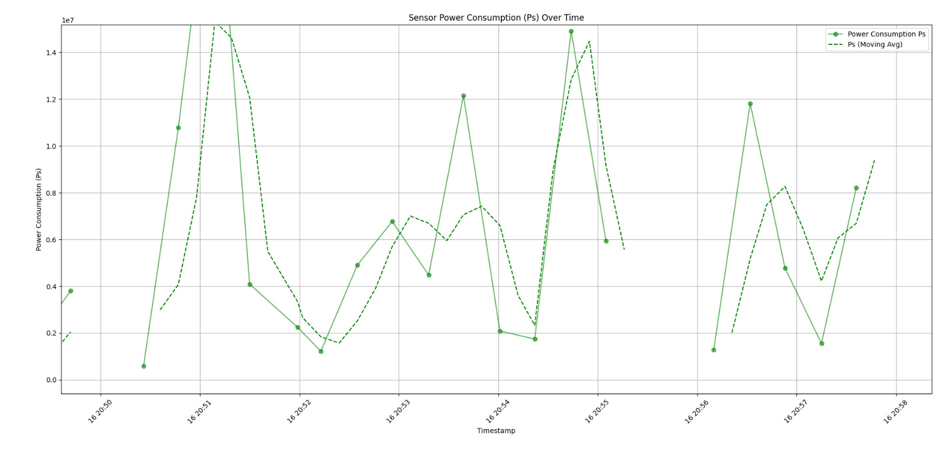

Slide 24
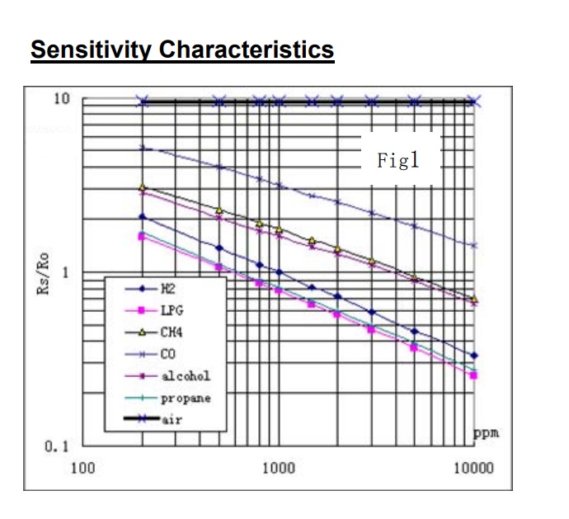
Site: https://www.pololu.com/file/0J309/MQ2.pdf

Slide 25
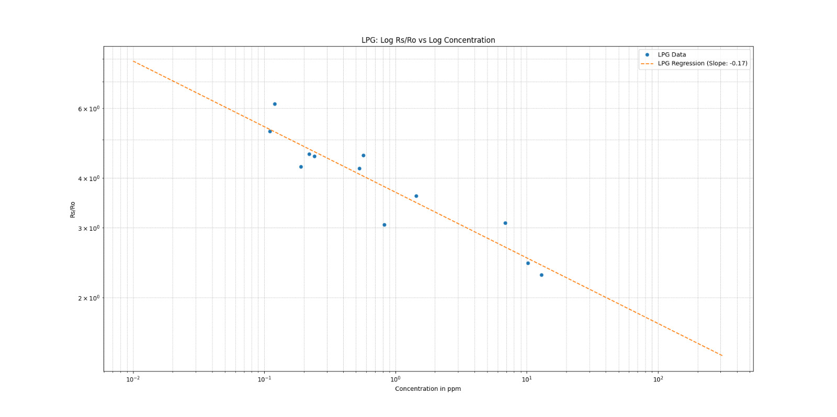

Slide 26
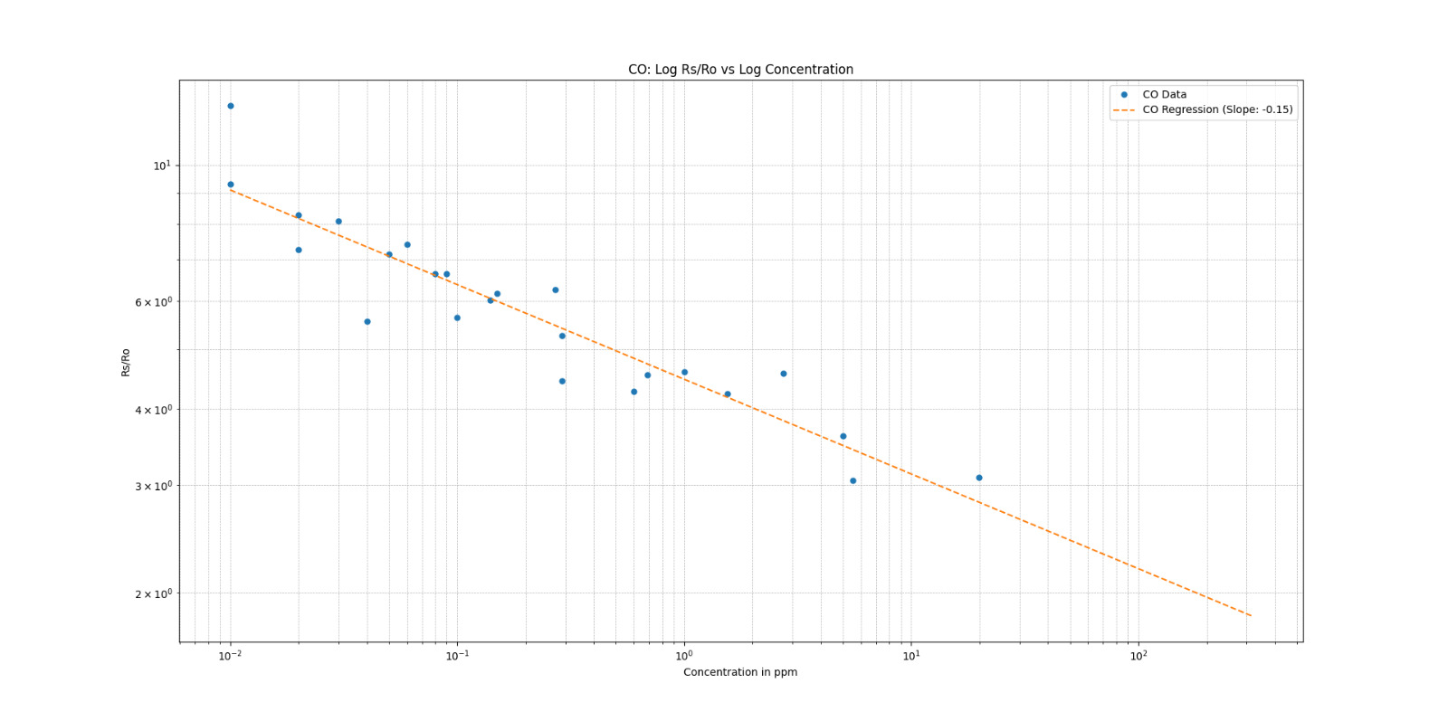

Slide 27
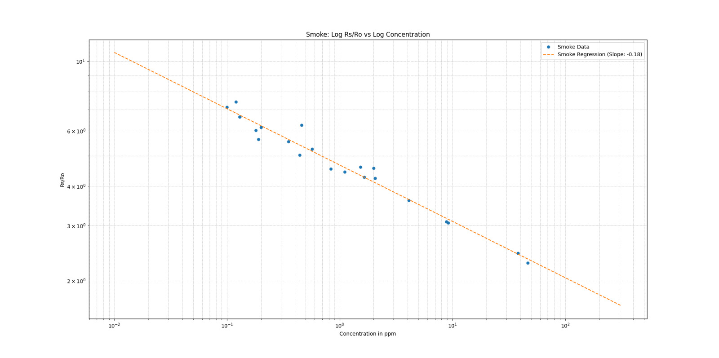

Slide 28
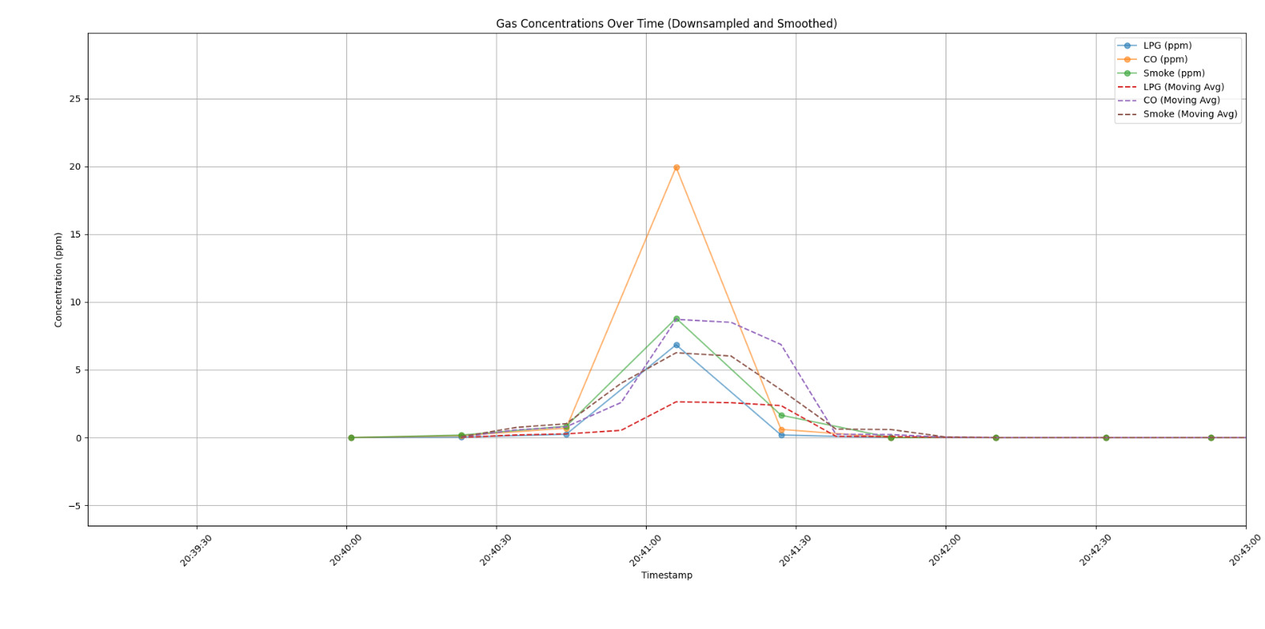
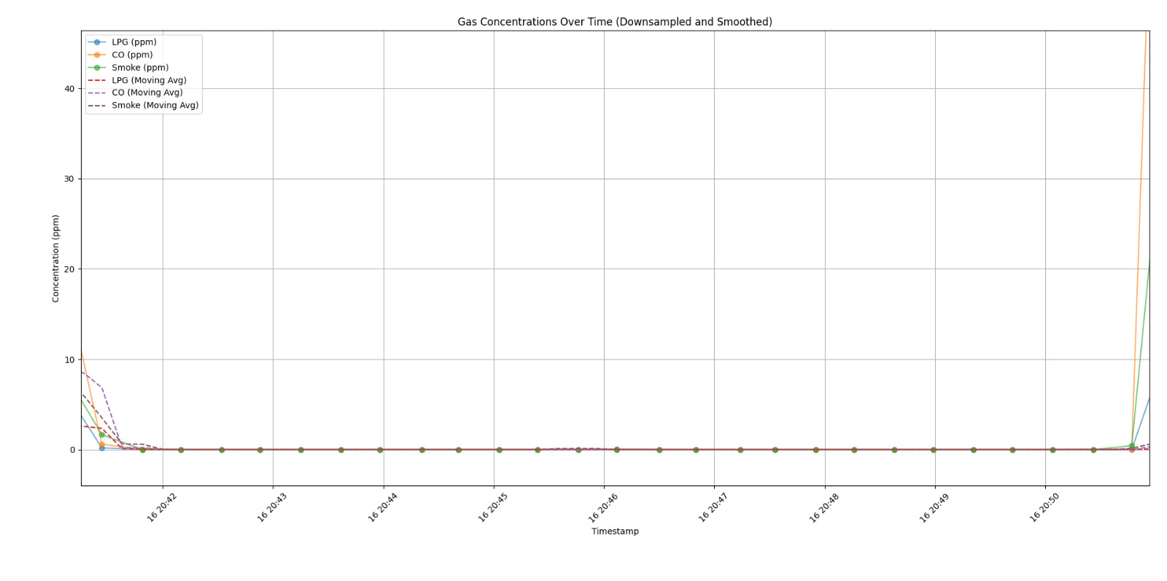
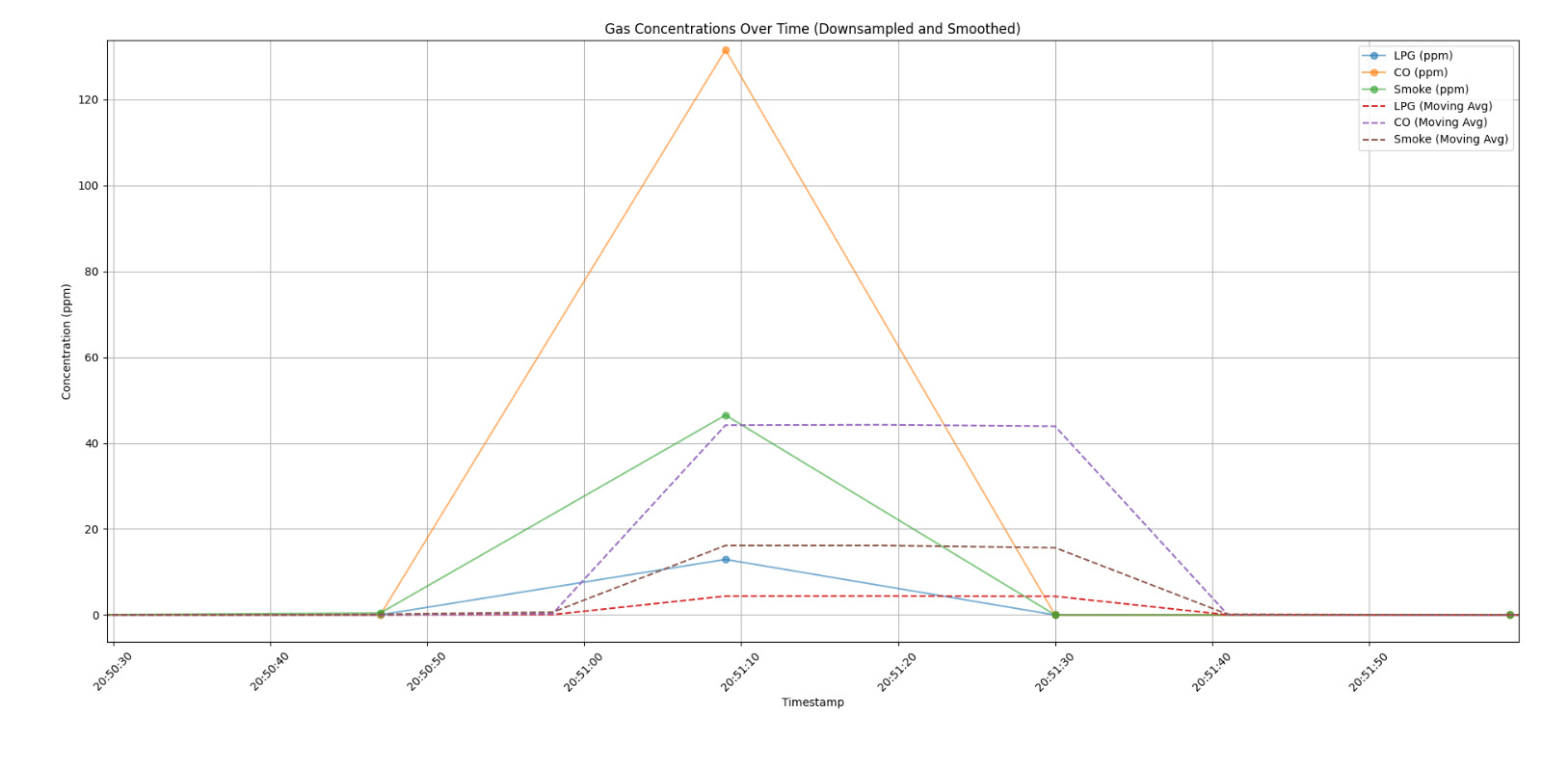
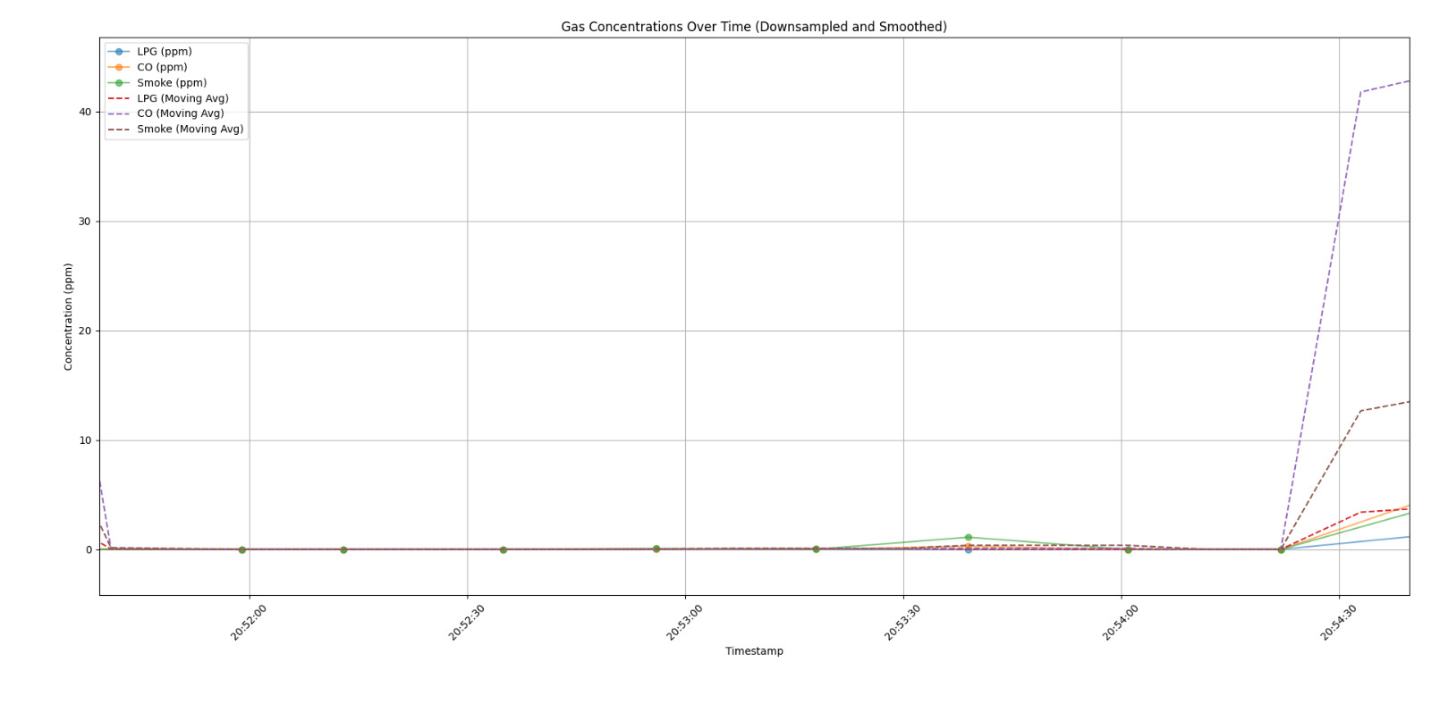

Slide 29
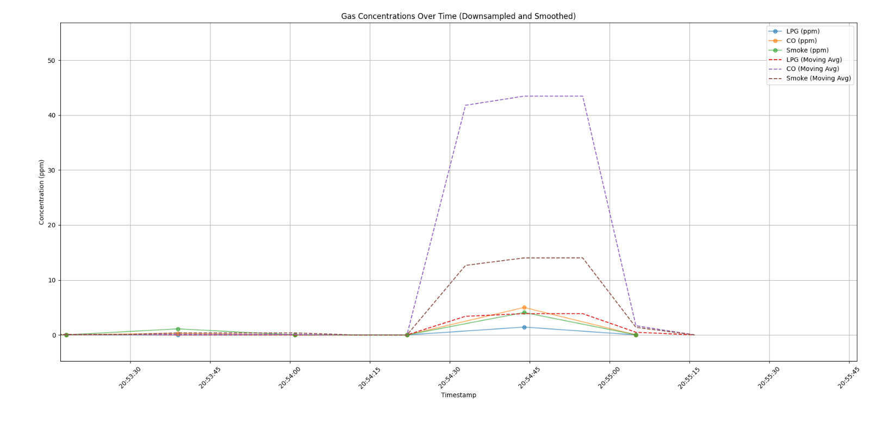
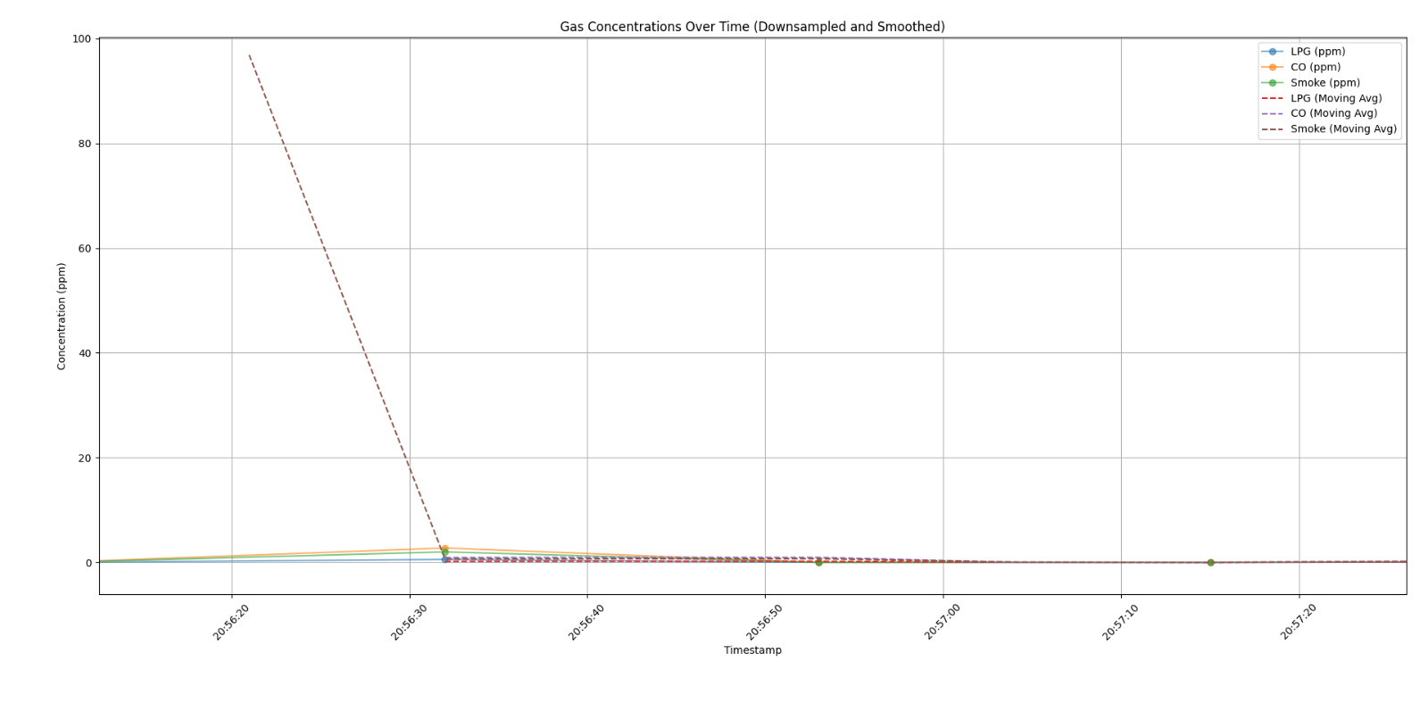

Slide 30
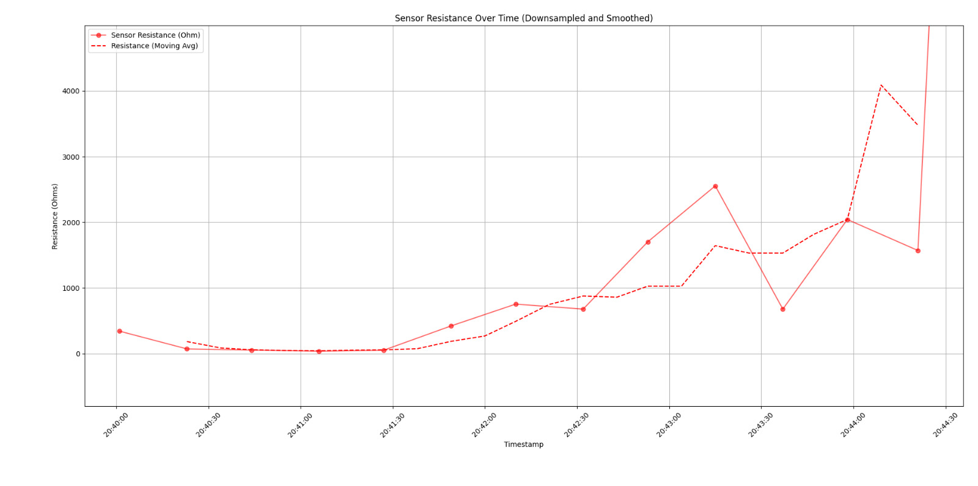
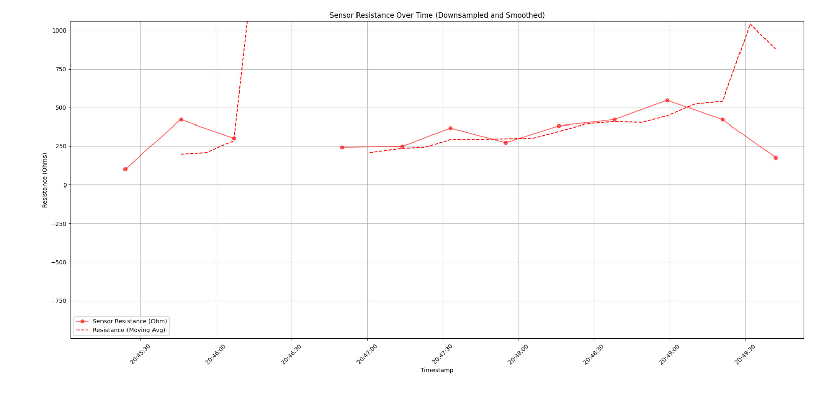
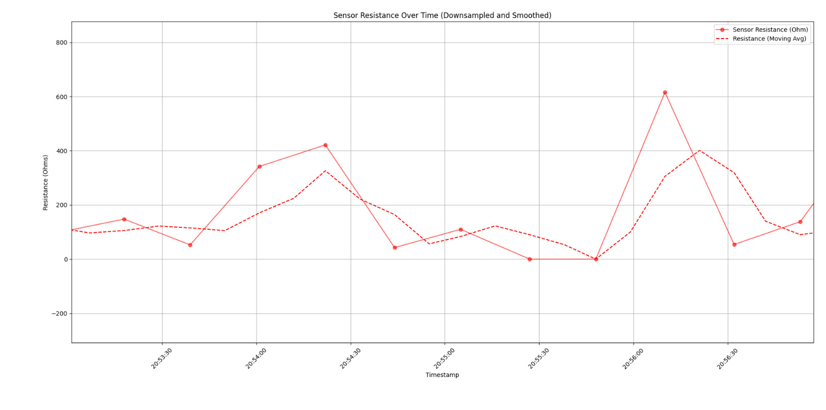

Slide 31
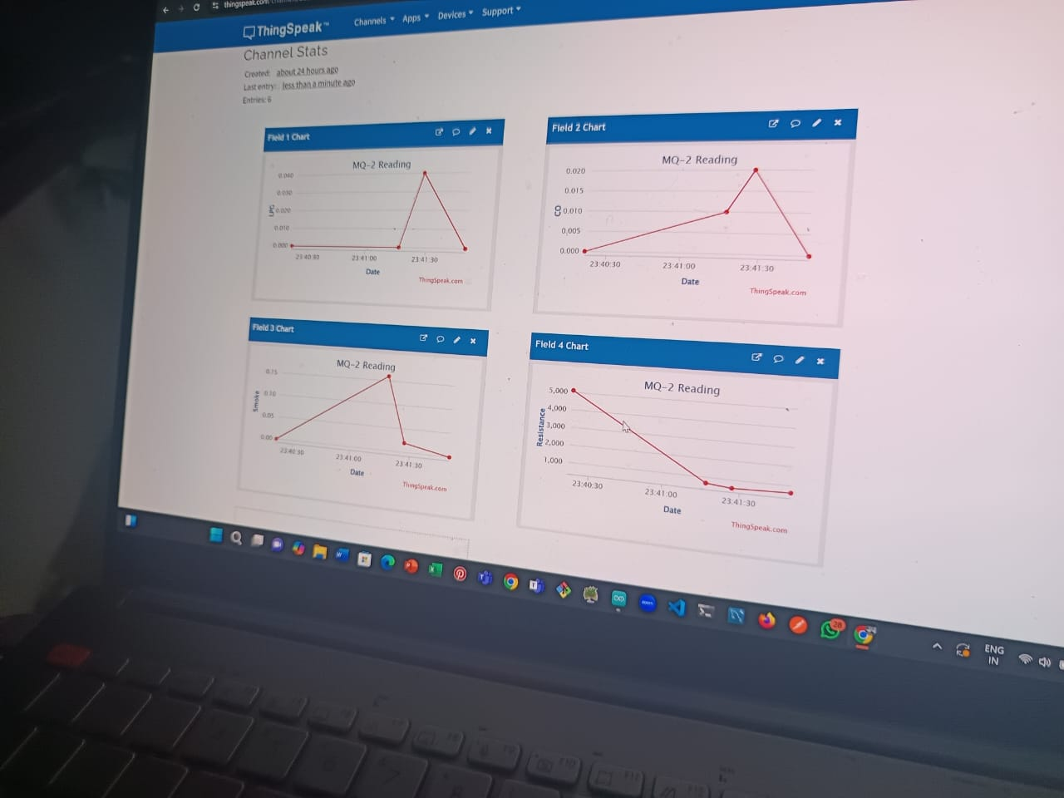

Slide 32
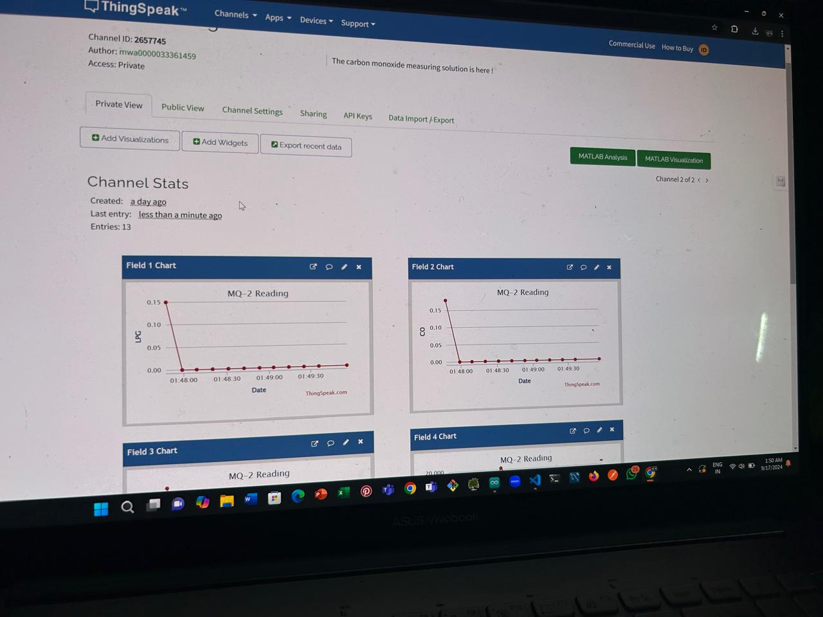

Slide 33
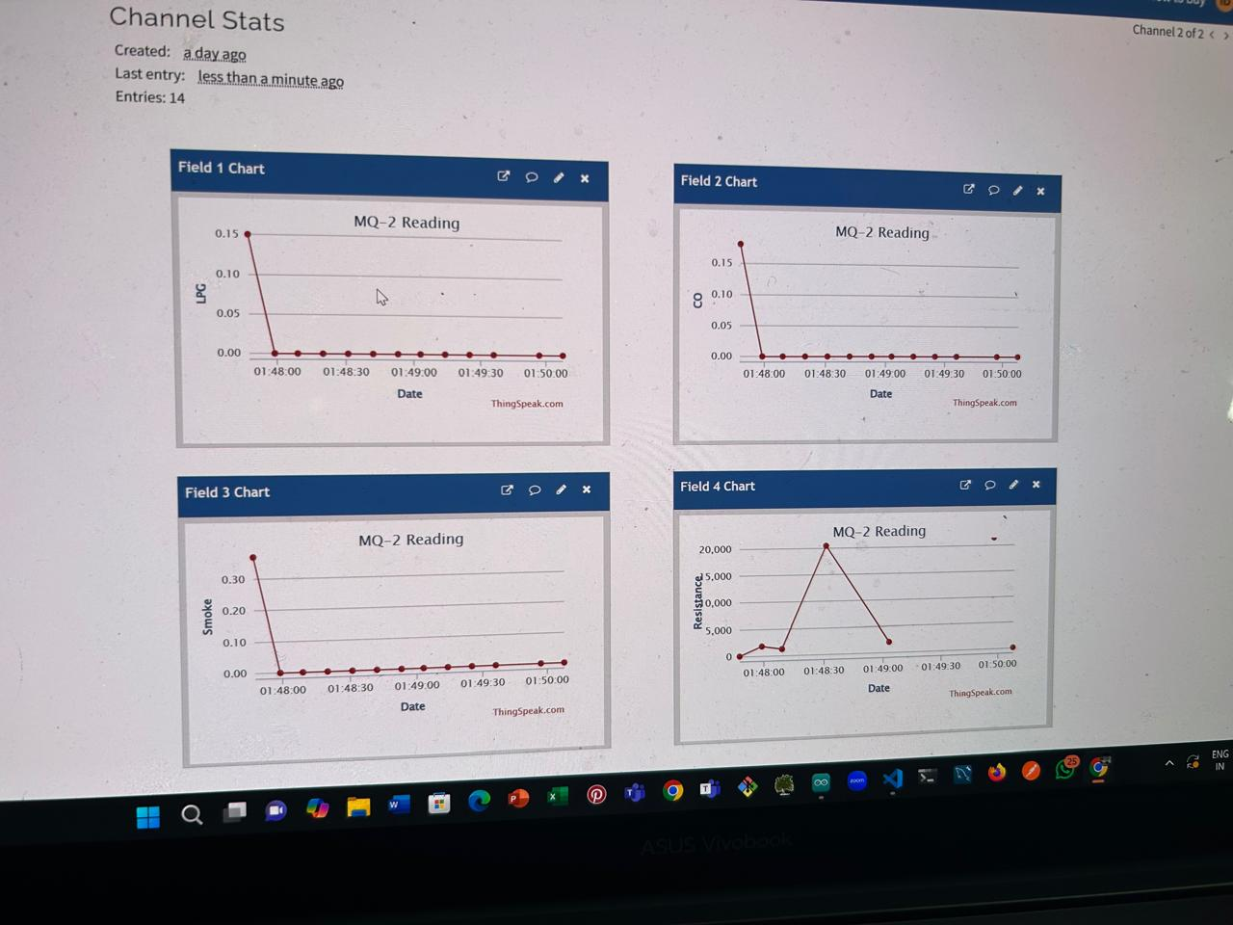

Slide 35
Targets for next week
Objectives:
Integration of actuators: will try to integrate DHT 11 sensor (next slide for plot) A lot of data collection will be done under controlled environment and a variety of different settings A minimum viable GUI of the platform will be made. Precise R(l) measurements will be made for future purposes and readings.

Slide 36
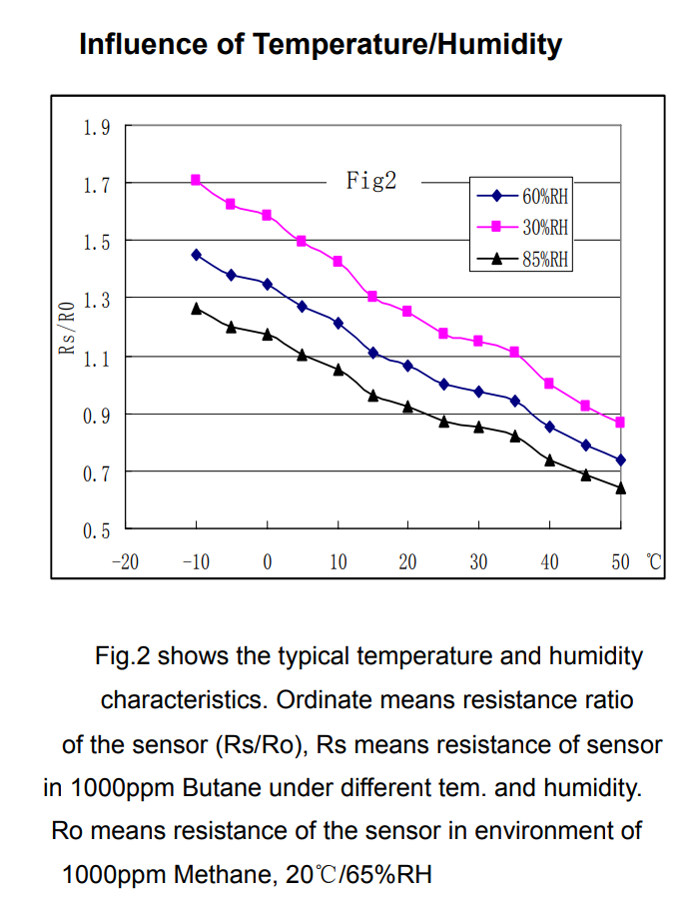
DHT 11 Integration plan:

